Slide 1
Data Structure Algorithm & Design

Slide 2
NP Complete

Slide 3
Plan of Lecture
Introduction to P Problem.
Introduction to NP. (By Cook & Levin)
Convert any problem in YES/NO problem
NPC (decision tree problem)
SAT problem
P Space problem (Checker Problem)
unsolvable: Guess from the current position of board, who will win.

Slide 4
P and NP
NP
P
As mentioned, P is set of problems that can be solved in polynomial time.
Most of the important algorithms we compute are somewhere in the O(log n) to O(n³) range and maximum of O(n⁴)
NP (Nondeterministic Polynomial time) is the set of problems that can be solved in polynomial time by a nondeterministic computer
Yes/No Machine
Exponential Possibilities
Solution

Slide 5
Nondeterminism
Yes/No Machine
Exponential Possibilities
Solution
Think of a non-deterministic computer as a computer that magically “guesses” a solution, then has to verify that it is correct
If a solution exists, computer always guesses it
One way to imagine it: a parallel computer that can freely spawn an infinite number of processes
Have one processor work on each possible solution
All processors attempt to verify that their solution works
If a processor finds it has a working solution
So: NP = problems verifiable in polynomial time

Slide 6
NP-Complete Problems
The NP-Complete problems are an interesting class of problems whose status is unknown
No polynomial-time algorithm has been discovered for an NP-Complete problem
No lower bound has been proved for any NP-Complete problem, either
We call this the P = NP question
The biggest open problem in CS
First NPC problem
SAT Problem (Satisfiability Problem)
P Space
NPC
NP
P

Slide 7
SAT
SAT = { f | f is a Boolean Formula with a satisfying assignment }
Is SAT in NP?
YES
3-SAT = { f | f is in Conjunctive Normal Form, each clause has exactly 3 literals and f is satisfiable }
3-SAT is NP-Complete

Slide 8
NP-Complete Problems
NP-Complete problems are the “hardest” problems in NP:
If any one NP-Complete problem can be solved in polynomial time…
…then every NP-Complete problem can be solved in polynomial time…
…and in fact every problem in NP can be solved in polynomial time (which would show P = NP)
Thus: solve Hamiltonian-cycle in O(n¹⁰⁰) time, you’ve proved that P = NP. Retire rich & famous.

Slide 9
An NP-Complete Problem: Hamiltonian Cycles
An example of an NP-Complete problem:
A Hamiltonian cycle of an undirected graph is a simple cycle that contains every vertex
The Hamiltonian-cycle problem: given a graph G, does it have a Hamiltonian cycle?
Draw on board:
Describe a naïve algorithm for solving the Hamiltonian-cycle problem. Running time?

Slide 10
Hamiltonian Circuit
Every node traversed only once and ends at the start node.
7 nodes in a graph. (A,B,C,D,E,F,G)
Make a guess suppose
b,g,e,c,d,a,f,b
Check (using adjacency list)
O(n[to make a guess] + e [check for the path])
Linear time in non determinism.
*Hamiltonian Cycle is different from Hamiltonian Path

Slide 11
clique
To find the biggest clique in the given graph (complete sub graphs of maximum nodes [maximum k complete graph])
Easy with fixed k

Slide 12
Find max k complete graph (find clique of k or more)
A
B
G
F
C
E
D

Slide 13
Reduction
The crux of NP-Completeness is reducibility
Informally, a problem P can be reduced to another problem Q if any instance of P can be “easily rephrased” as an instance of Q, the solution to which provides a solution to the instance of P
What do you suppose “easily” means?
This rephrasing is called transformation.
Intuitively: If P reduces to Q, P is “no harder to solve” than Q

Slide 14
Reducibility
An example:
P: Given a set of Booleans, is at least one TRUE?
Q: Given a set of integers, is their sum positive?
Transformation: (x₁, x₂, …, x_{n}) = (y₁, y₂, …, y_{n}) where y_{i} = 1 if x_{i} = TRUE, y_{i} = 0 if x_{i} = FALSE
Another example:
Solving linear equations is reducible to solving quadratic equations
How can we easily use a quadratic-equation solver to solve linear equations?

Slide 15
Using Reductions
If P is polynomial-time reducible to Q, we denote this P ≤_{p} Q
Definition of NP-Complete:
If P is NP-Complete, P ∈ NP and all problems R are reducible to P
Formally: R ≤_{p} P ∀ R ∈ NP
If P ≤_{p} Q and P is NP-Complete, Q is also NP-Complete
This is the key idea you should take away today

Slide 16
SAT <= 3SAT (reduction)
(X).(Y+X’+W+U).(X+Y+Z).(X+Z’)…….
(X) :-> (X+a+b).(X+a+b’).(X+a’+b).(X+a’+b’)
(X+Y+Z) :-> (X+Y+Z)
(X+Z’) :-> (X+Z’+c).(X+Z’+c’)
(Y+X’+W+U) :-> (Y+X+d).(d’+W+U)
Here a, b, c, d are my own variables, (not used in the clause)
The expression can contain any number of variables.
This reduction is in polynomial time only.

Slide 17
3 colourability<= SAT
A
B
D
C
You need to color the graph using 3 colors, i,e RGB
Now the question is how to convert this problem to 3SAT problem, to prove that this is an NPC problem.
Every node will be of single color.
This can be expressed in the form of variables
Every edge of the graph need to be stored in form of variables, s.t.
Adjacent node cannot be same color.
A
B
D
C

Slide 19
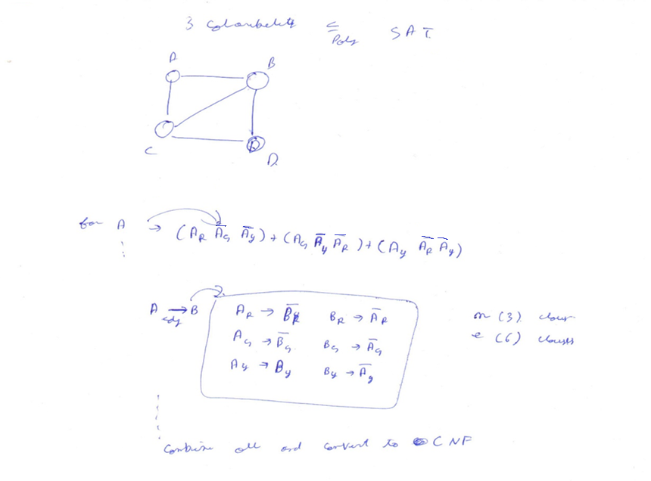

Slide 20
Example: Clique
CLIQUE = { <G,k> | G is a graph with a clique of size k }
A clique is a subset of vertices that are all connected
Why is CLIQUE in NP?

Slide 21
Reduce 3-SAT to Clique
Pick an instance of 3-SAT, Φ, with k clauses
Make a vertex for each literal
Connect each vertex to the literals in other clauses that are not the negation
Any k-clique in this graph corresponds to a satisfying assignment

Slide 22
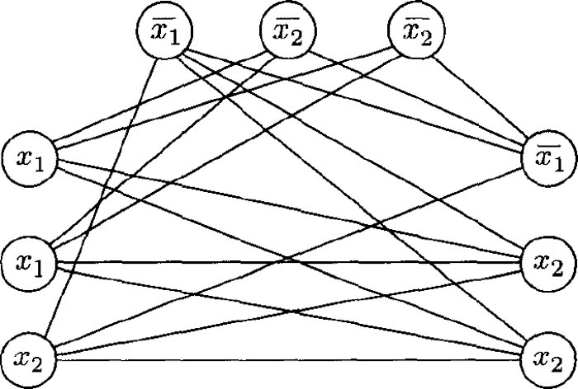

Slide 23
Why Prove NP-Completeness?
Though nobody has proven that P != NP, if you prove a problem NP-Complete, most people accept that it is probably intractable
Therefore it can be important to prove that a problem is NP-Complete
Don’t need to come up with an efficient algorithm
Can instead work on approximation algorithms

Slide 24
Proving NP-Completeness
What steps do we have to take to prove a problem P is NP-Complete?
Pick a known NP-Complete problem Q
Reduce Q to P
Describe a transformation that maps instances of Q to instances of P, s.t. “yes” for P = “yes” for Q
Prove the transformation works
Prove it runs in polynomial time
prove P ∈ NP (What if you can’t?)

Slide 25
Techniques for Dealing with NP-complete Problems
Exactly
Backtracking, Branch and Bound
Approximately
Approximation algorithms with performance guarantees
using LP (e.g., randomized rounding)
Local search, Tabu search
Simulated annealing
….
Change the problem.

Slide 26
Thank You

